Slide 1
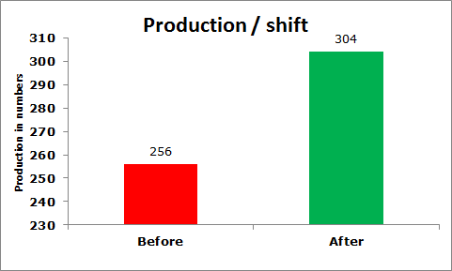
P15
KAIZEN NO :- 11
ACTIVITY
KK
QM
PM
JH
SHE
OT
DM
E&T
KAIZEN IDEA SHEET
TPM CIRCLE NAME: Achiever
LOSS NO. / STEP
DEPT :- MACHINE SHOP
RESULT AREA
P
Q
A,B,C
C
D
S
M
CELL:- Gear Shifter
CELL NAME:- A463 Body
MACHINE / STAGE :- VMC Super Dart -15
OPERATION :- Machining.
KAIZEN THEME : To Improve Productivity.
IDEA :- Club set ups.
Problem / Present Status :-
Production Rate – 256 / shift
COUNTERMEASURE :- We have modified a fixture so that both set ups can be done on common machine in single cycle.
BENCHMARK
separate set up at mac.
TARGET
All operation in MC
KAIZEN START
02.04.2016
TDC
05.04.2016
KAIZEN FINISH
TEAM MEMBERS : 1) Umesh Pimple, 2) Ajit Deokar.
BENEFITS :-
1 Productivity Improved.
After
KAIZEN SUSTENANCE
WHY - WHY ANALYSIS :-
Why1 :- Production rate 256 / shift.
Why2 :- High loading and unloading time.
Why3 :- 2 separate VMC machines for 2 different set ups .
RESULT :-
Production / Shift Increased
by 48Nos.
2) Target meet in 2 shifts
3) 1 manpower saved / day .
WHAT TO DO:- N.A
HOW TO DO:- N.A
ROOT CAUSE :- 2 separate VMC machines for 2 different set ups .
REGISTRATION NO. & DATE : 2.04.2016
SCOPE & PLAN FOR HORIZONTAL DEPLOYMENT
REGISTERED BY :- Umesh Pimple
SR.
NO.
CELL
TARGET
RESPONSIBILITY
STATUS
MANAGER’S SIGN :- D. Y. Pawar
1
---------
-------
---------
--------

